Slide 1
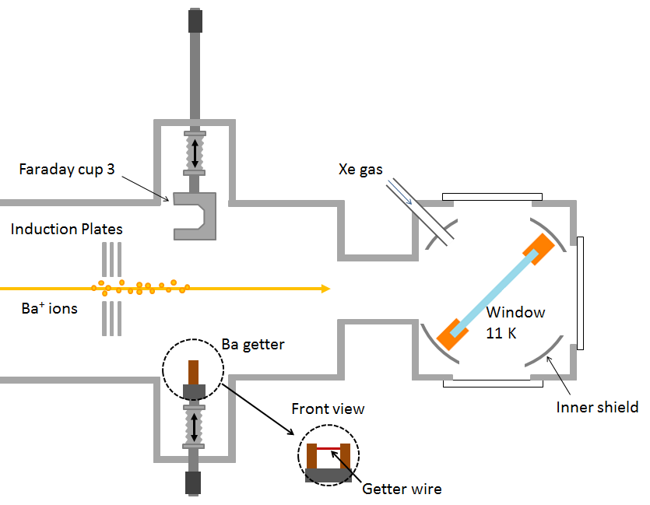
Ba⁺/Ba Deposition

Slide 2
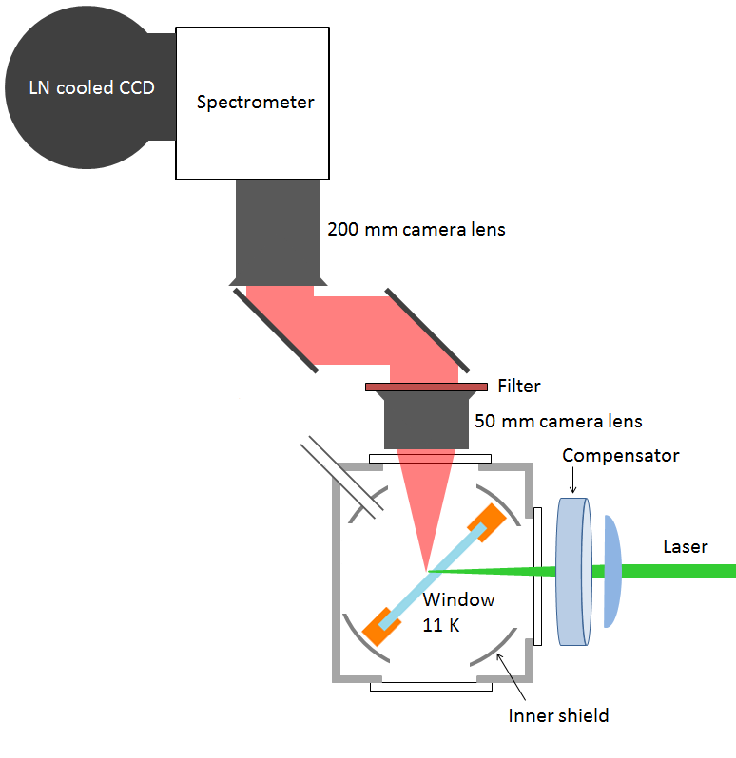

Slide 3
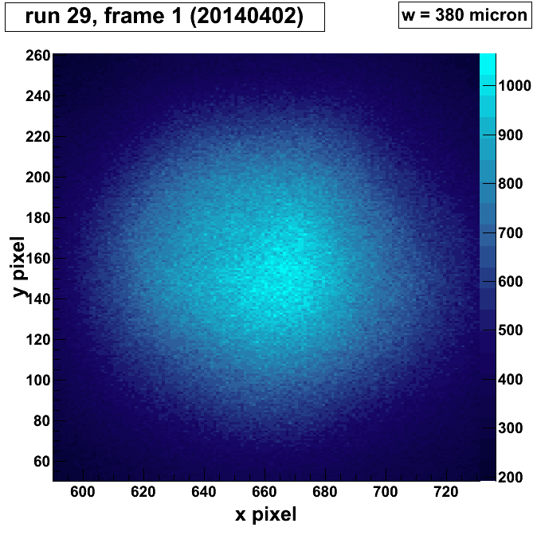
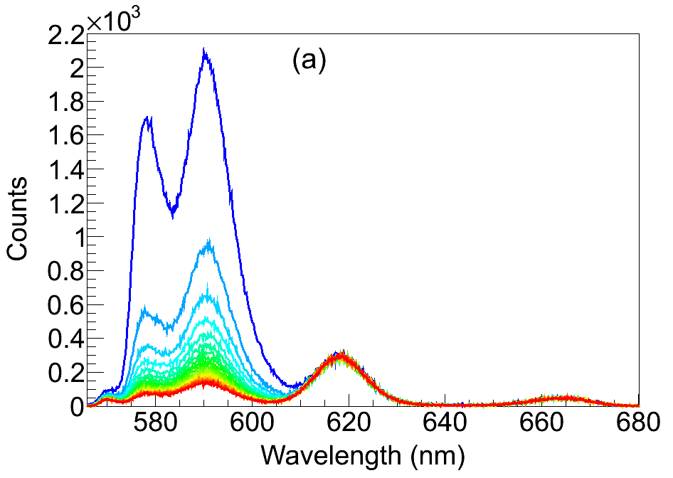
Image of fluorescence by semi-focused laser:

Slide 4
Summary: optimal conditions for observing Ba in SXe
1) Deposit at 50 ± 5 K, observe at 11 K

Slide 5
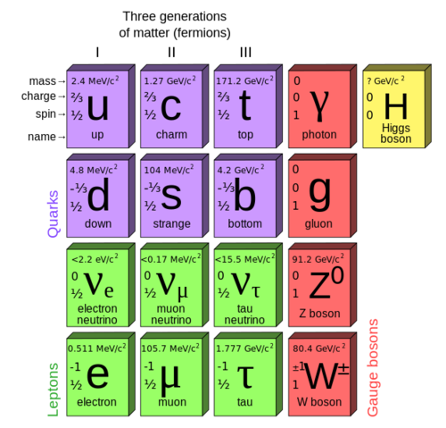
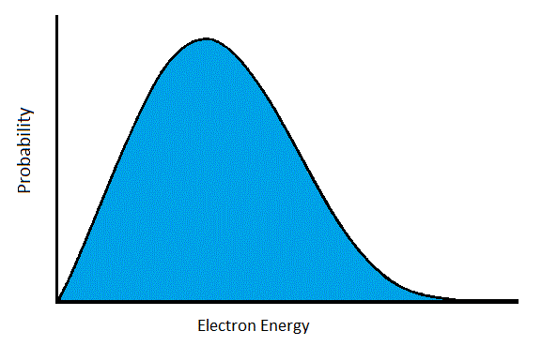
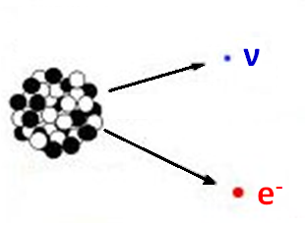
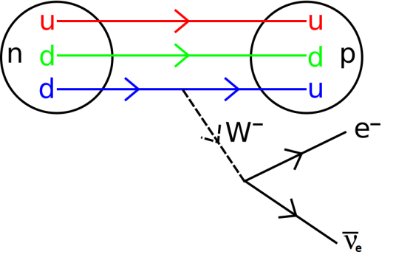
Neutrinos
First indications: beta decay spectrum
Interact only via Weak Force (and Gravity)
Very small mass

Slide 6
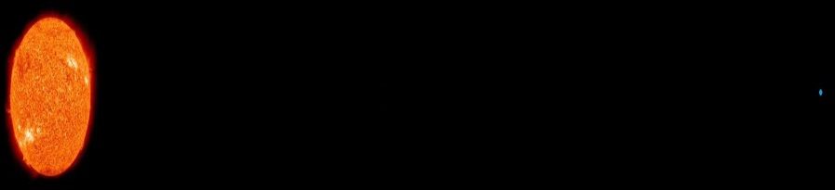
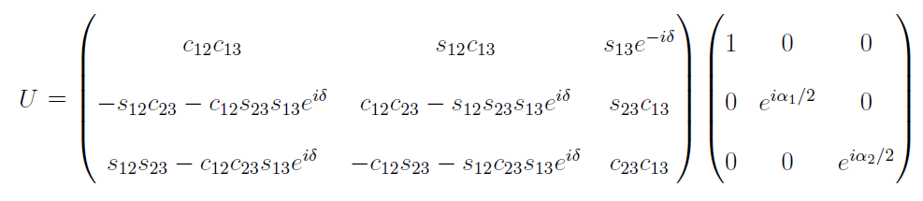
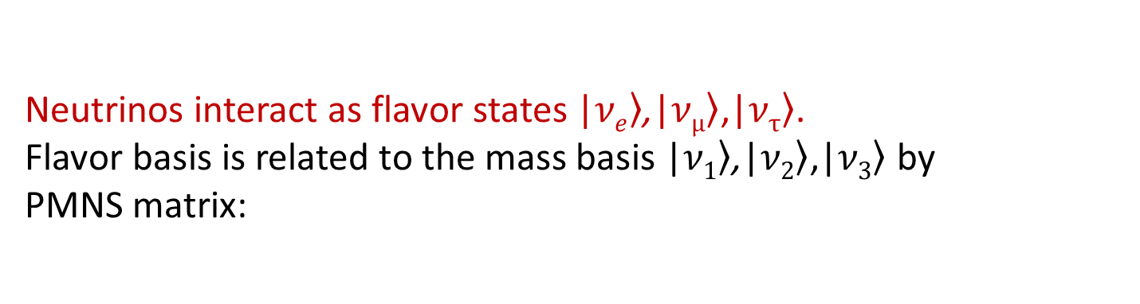
Neutrino oscillation
ν_{e}
ν_{μ}
Neutrinos interact as flavor states |$\left.νe\right\rangle$,|$\left.νμ\right\rangle$,|$\left.ντ\right\rangle$.
Flavor basis is related to the mass basis |$\left.ν1\right\rangle$,|$\left.ν2\right\rangle$,|$\left.ν3\right\rangle$ by
PMNS matrix:
s_{ij} = sin θ_{ij}, c_{ij} = cos θ_{ij}, and δ, α₁, α₂ are CP-violating phases.
With m_{ν} << p_{ν}, time-evolution is determined by mass squared differences Δm₂₁² = m₂² – m₁² and Δm₃₁² = m₃² – m₁².
Neutrino oscillation requires non-zero mass squared differences.

Slide 7
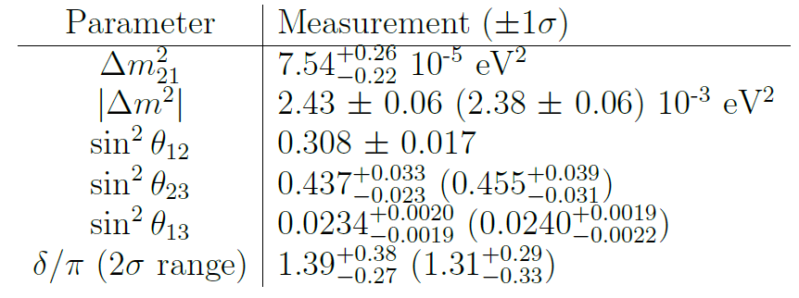
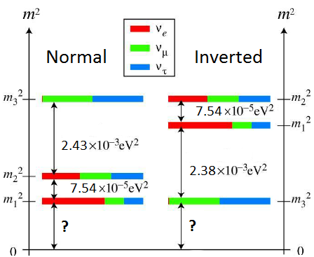
Neutrino oscillation
ν_{e}
ν_{μ}
Neutrino mixing measurements given Normal (Inverted) Hierarchy:
Neutrino Mass Hierarchy
2012 Review by K. Nakamura, U. Tokyo, S.T. Petcov

Slide 8
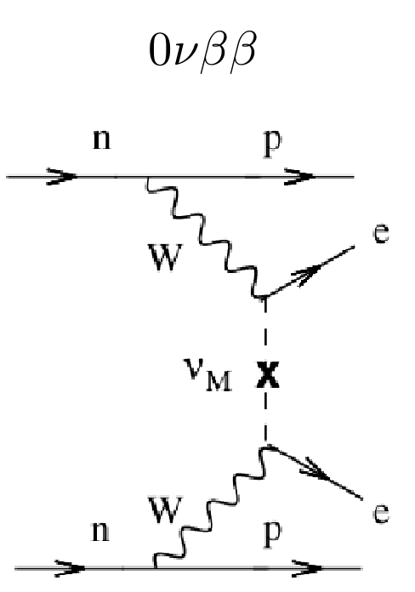

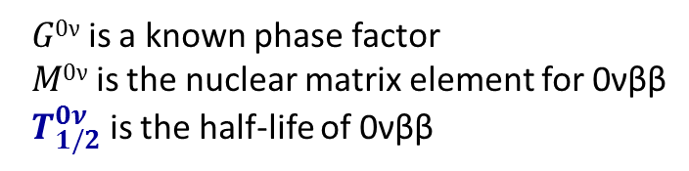
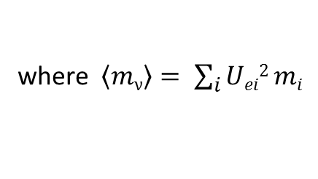
Much yet to learn…
What is the fundamental nature of neutrinos? (Why is their mass so small? Are they Majorana or Dirac particles?)
What is the absolute mass scale of the neutrinos?
Do they violate CP and/or Lepton Number conservation?
A method: search for Neutrinoless Double Beta Decay (0νββ)
Observation of this decay would:
prove that neutrinos are Majorana fermions
measure absolute neutrino mass in the form of effective electron-neutrino mass:
${\left\langle mν\right\rangle }^{2}=[{ T}_{1/2}^{0ν}{ G}_{}^{0ν}$(Q,Z) ${\left|M0ν\right|}^{2} ] ¯1$
where $\left\langle mν\right\rangle = \sum_{i}{Uei2 mi}$
$G0ν$ is a known phase factor
$M0ν$ is the nuclear matrix element for 0νββ
${ T}_{1/2}^{0ν}$ is the half-life of 0νββ

Slide 9
Barium Tagging in Solid Xenon
Requires:
Position of 2β decay known (TPC)
Understanding of Ba/Ba⁺ fluorescence in solid xenon
Detection sensitivity at single atom/ion level

Slide 10

Barium Tagging in Solid Xenon
Requires:
Position of 2β decay known (TPC)
Understanding of Ba/Ba⁺ fluorescence in solid xenon
Detection sensitivity at single atom/ion level

Slide 11
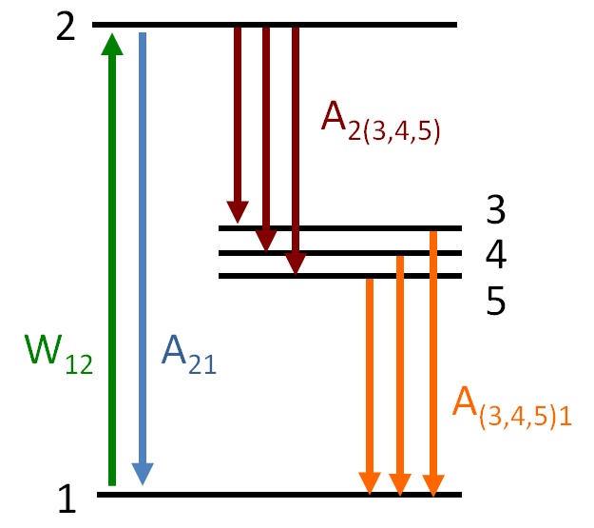
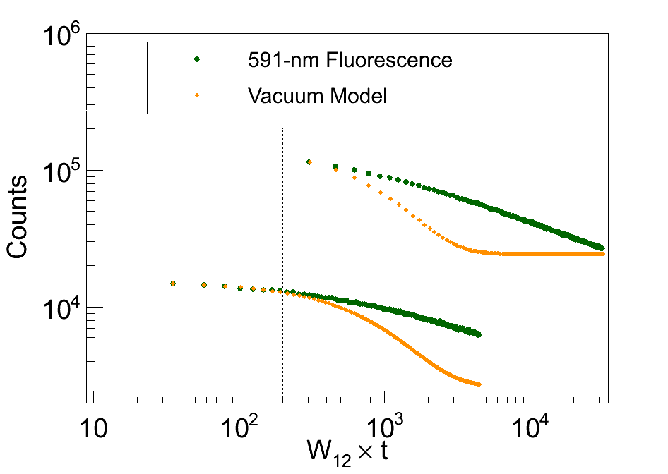
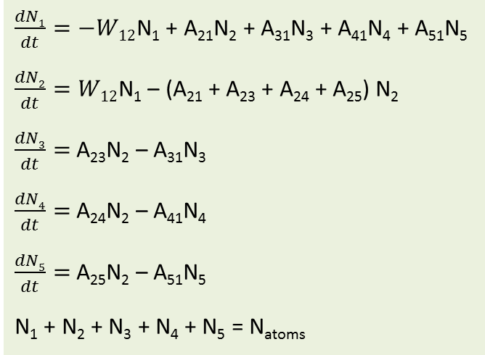
Bleaching Model
$\frac{dN1}{dt}=−W12$N₁ + A₂₁N₂ + A₃₁N₃ + A₄₁N₄ + A₅₁N₅
$\frac{dN2}{dt}=W12$N₁ – (A₂₁ + A₂₃ + A₂₄ + A₂₅) N₂
$\frac{dN3}{dt}=$A₂₃N₂ – A₃₁N₃
$\frac{dN4}{dt}=$A₂₄N₂ – A₄₁N₄
$\frac{dN5}{dt}=$A₂₅N₂ – A₅₁N₅
N₁ + N₂ + N₃ + N₄ + N₅ = N_{atoms}
Rates in vacuum:
A₂₁=1.2x10⁸ s⁻¹
A₂₃=2.5x10⁵ s⁻¹
A₂₄=1.1x10⁵ s⁻¹ branching ratio 0.003
A₂₅=3.1x10³ s⁻¹
A₃₁=5 s⁻¹
A₄₁=0.014 s⁻¹ very slow metastable decay
A₅₁=0.017 s⁻¹
Compare numerical solution to above equations (normalized) to 591-nm Ba fluorescence data:
Disagreement may be due to altered rates in SXe
Agreement for first ~200 excitations
Still, re-pump lasers may eliminate/reduce bleaching.
# Excitations

Slide 12
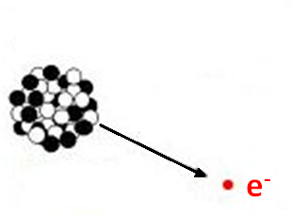
Neutrinos
First indications ~1930: beta decay spectrum
e⁻ energy expected here
broad e⁻ energy distribution indicated “missing” energy

Slide 13
Neutrinos
First indications ~1930: beta decay spectrum
Pauli predicted another particle emitted which is not detected

Slide 14
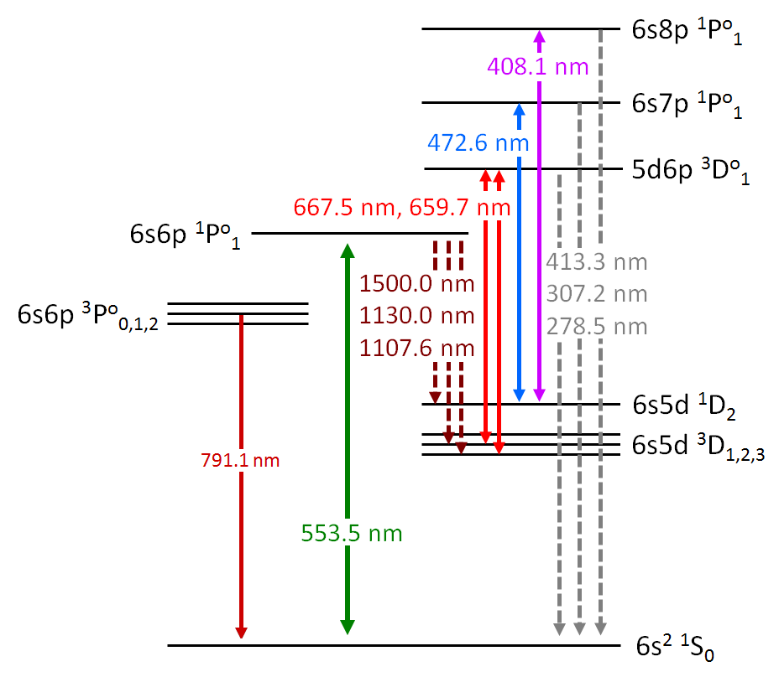
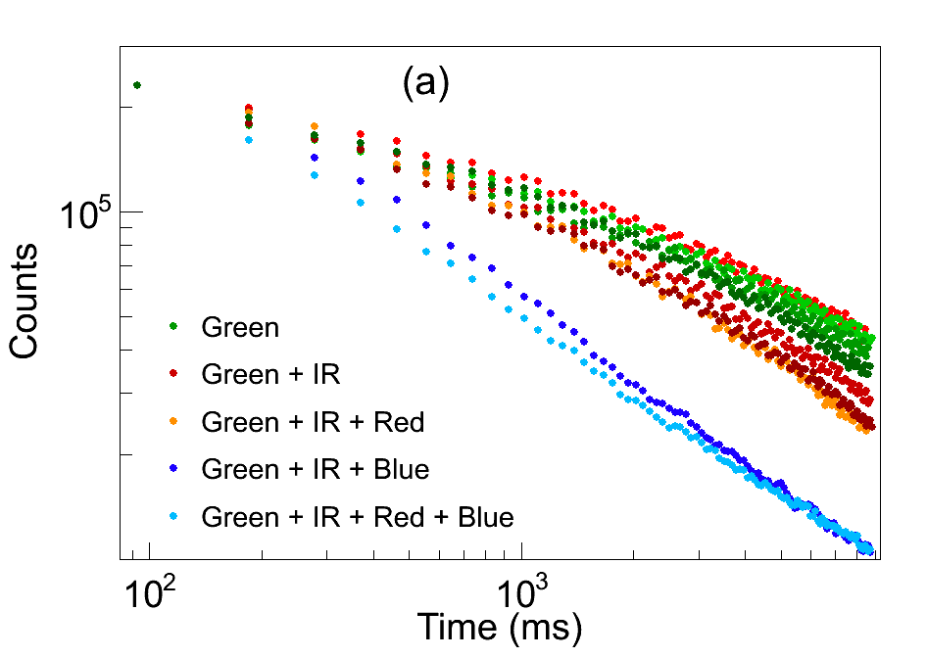
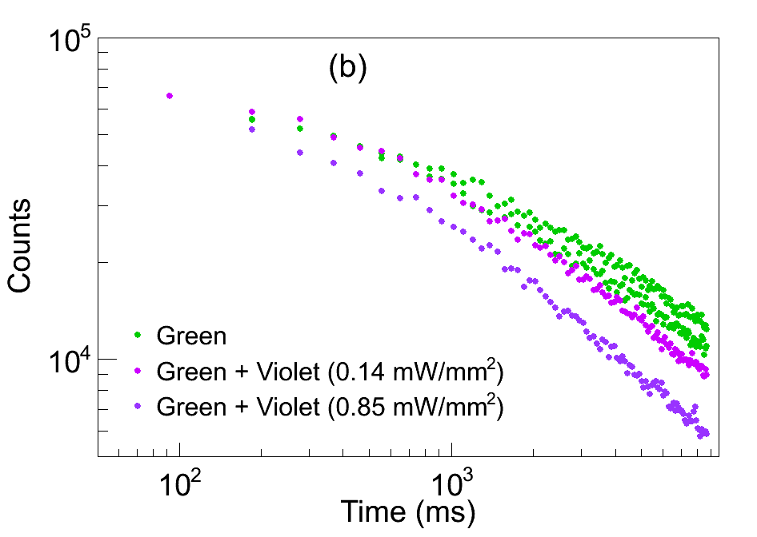
Re-pump Attempts
w/ inexpensive and on-hand Lasers
Higher-level states may provide re-pump paths (in addition to direct IR transitions).
e.g., 659.7 nm used along with 1130.0 nm and 1500.0 nm for
Ba MOT in Phys. Rev. A 79, 041402(R) (2009)
Ba in Vacuum
591-nm fluorescence vs. time w/ and w/o additional lasers:
No positive effect from these additional lasers (only increased bleaching)
Green: 555 nm (dye)
IR: 1064 nm (Nd:YAG)
+ 1550 nm (diode)
Red: 657 nm (diode)
Blue: 473 nm (dye)
Violet: 406 nm (Kr ion laser)

Slide 15
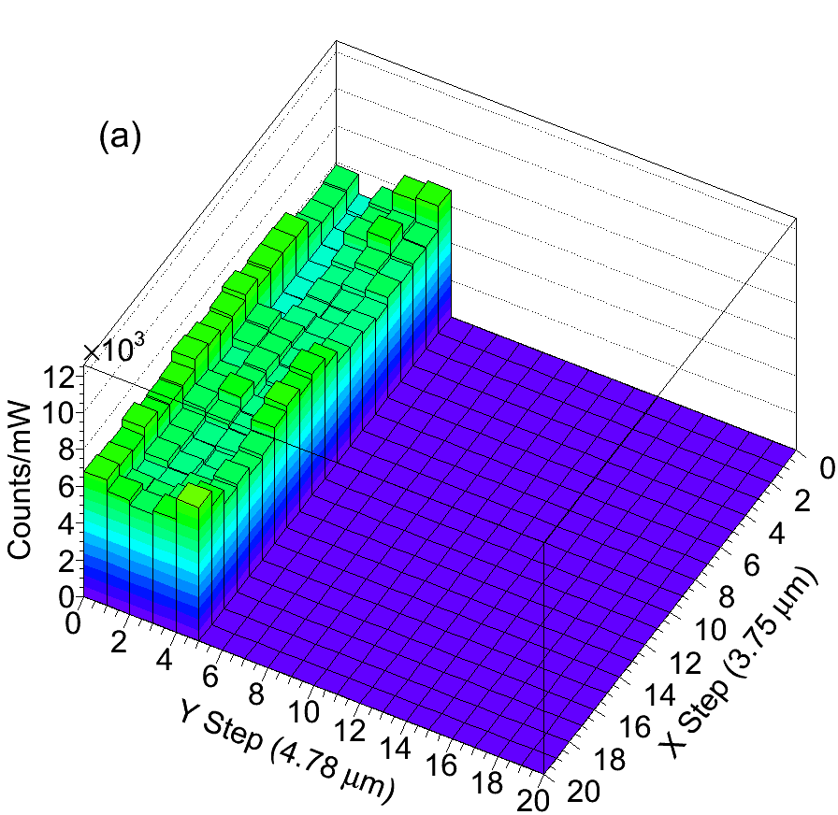
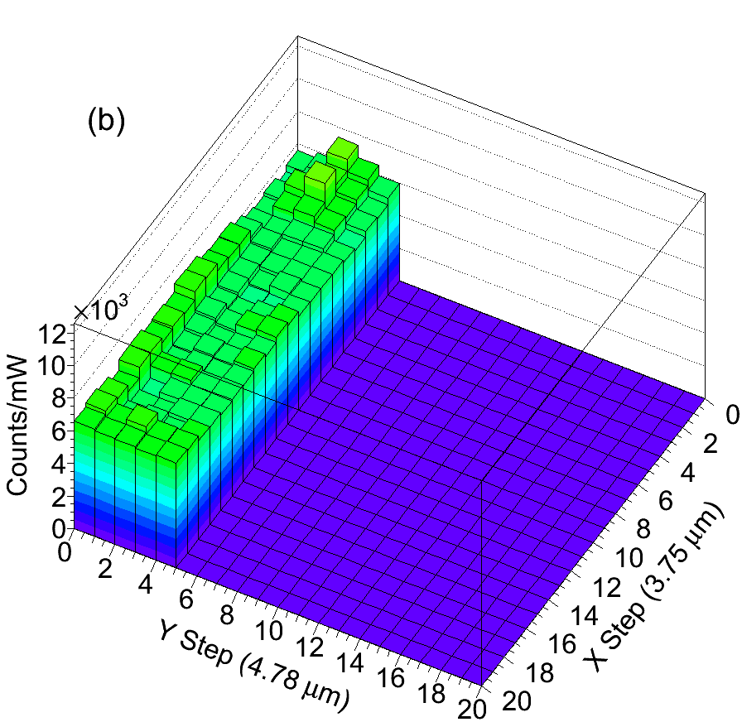
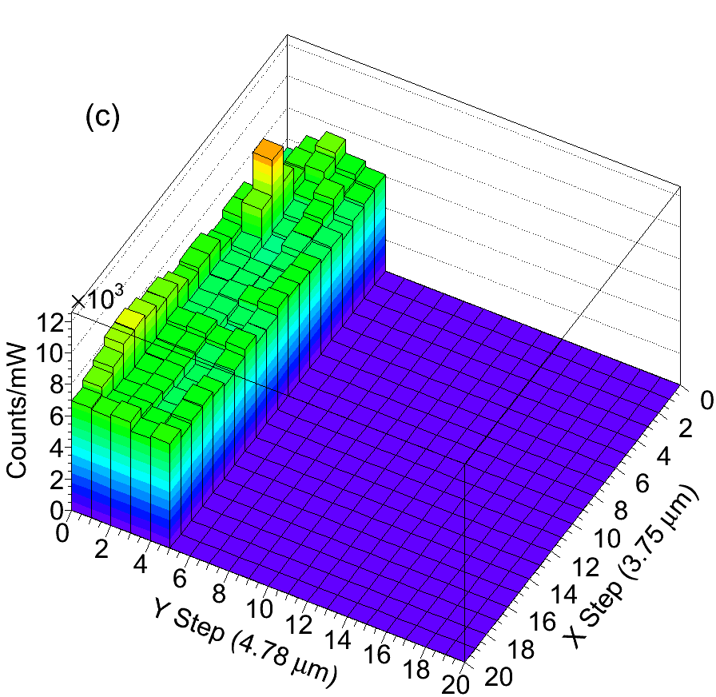
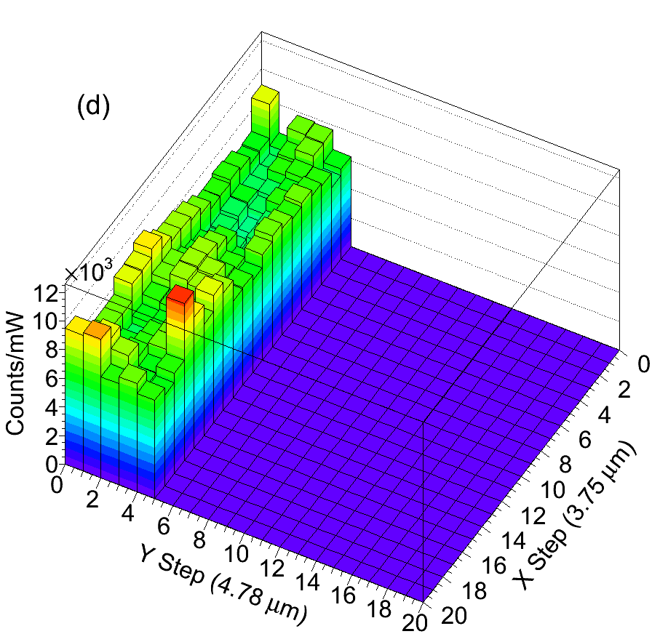
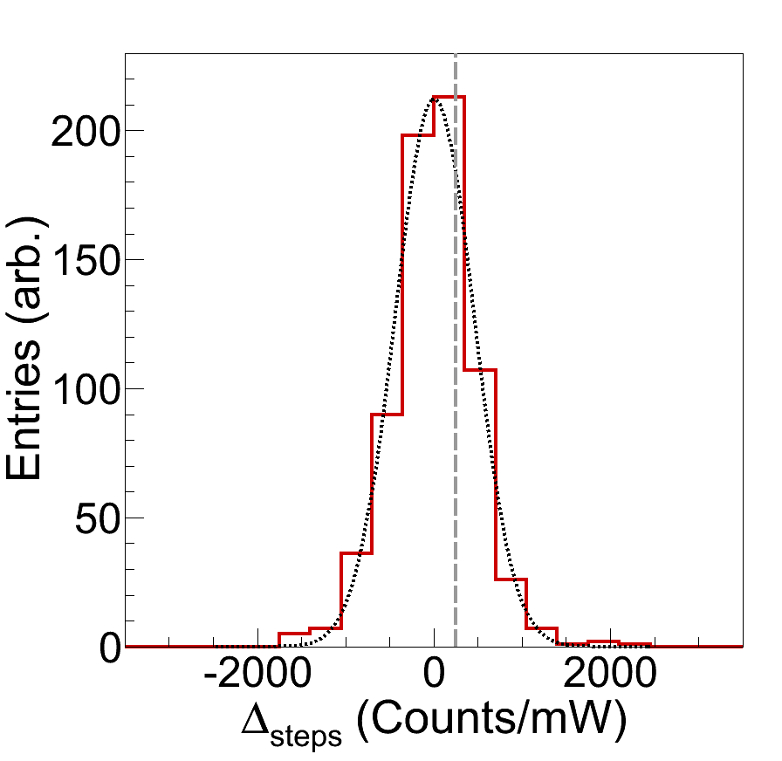
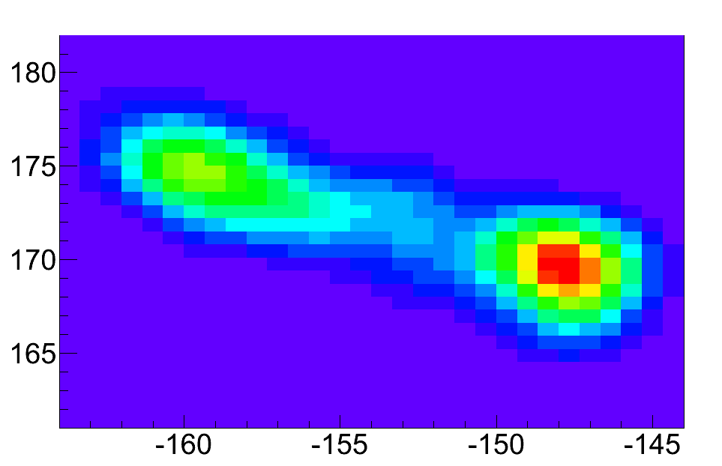
First Attempts at Scanned Images
≤ 0.48 Ba/step
Xe-only
≤ 0.63 Ba/step
≤ 5.7 Ba/step
Trend-line single-Ba signal level
(10-s exposure)
Need to reduce surface background:
Separation by fluorescence lifetimes
Acid etching
Synchronize laser gating w/ vibrations:
Step-to-step variation in surface BG competes w/ single-atom signal level:
×

